Slide 1
A STUDY ON CONDITIONAL GENERATIVE ADVERSARIAL NETWORK USING RETINAL FUNDUS IMAGES
Presented by:
Ashutosh Choudhury (18)
Loknath Ghosh (55)
Tushar Sarkar (27)
Sayan Mukherjee (10)
Rahul Majumder (11)

Slide 2
Problem Space
We have Digital Retinal Images for Vessel Extraction Dataset with a sample training set image displayed beside.
The retinal image is a digital picture of the back of the eye and is widely used in medical diagnosis due to cardiovascular disease, diabetic retinopathy, hypertension, and glaucoma.
Our aim is to make a conditional GAN model where the problem space includes the generation of RGB retinal images corresponding to the position of the optic disk region i.e. position control.

Slide 3
Problem Solving Approach
The dataset of three images consisting of the ground truth, retinal image and mask is used to first generate an image where the blood vessels are removed.
The removed vessels are filled using bernstein polynomial mathematical expression in the green channel.
After getting the new green image we perform feature extraction using a 3x3 matrix window and region creation using K-Means Clustering algorithm.
The features are used to create three clusters henceforth which we generate three regions of a retinal image i.e. a high contrast region, low contrast region and an optic disc region.

Slide 4
Approach in GAN
We're training a conditional GAN with a specific focus: using only the optic disc region to generate RGB retinal images and precisely control the position of the generated image relative to the optic disc region.
We generate 100-dimensional vectors from optic disc images, with the number of vectors matching the batch size. For instance, a batch size of 120 corresponds to 120 vectors, each containing 100 dimensions.
The generator receives 100-dimensional vectors representing optic disc region images to produce RGB retinal images. The discriminator is fed with real retinal image data to differentiate between real and generated images.
The GAN model aims to generate high-quality retinal images with precise positioning relative to an optic disc region.

Slide 5


Bernstein Polynomial
In the mathematical field of numerical analysis, a Bernstein polynomial is a polynomial that is a linear combination of Bernstein basis polynomials.
The n +1 Bernstein basis polynomials of degree n are defined as:
where is a binomial coefficient.
So, for example,

Slide 6
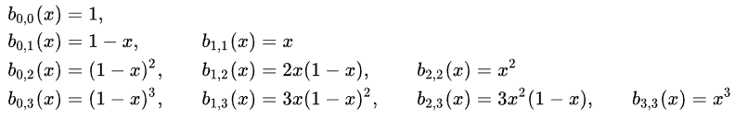
The first few Bernstein basis polynomials fo 1, 2, 3 or 4 values together are:
The Bernstein polynomial is used to define and manipulate curves and surfaces in computer graphics and geometric modeling.

Slide 7
K-Means Clustering
K-Means Clustering is an Unsupervised Learning algorithm, which groups the unlabeled dataset into different clusters. Here K defines the number of pre-defined clusters that need to be created in the process, as if K=2, there will be two clusters, and for K=3, there will be three clusters, and so on.
It allows us to cluster the data into different groups and a convenient way to discover the categories of groups in the unlabeled dataset on its own without the need for any training.

Slide 8
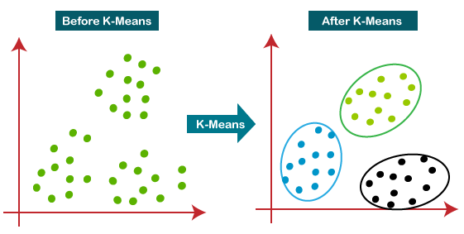
The k-means clustering algorithm mainly performs two tasks:
(a) Determines the best value for K center points or by an iterative process.
(b) Assigns each data point to its closest k-center. Those data points which are near to the particular k-center, create a cluster.
Hence each cluster has data points with some commonalities, and it is away from other clusters.
The working of K-means Clustering Algorithm is shown in the figure below.

Slide 9
GAN and DCGAN
GANs, invented by Ian Goodfellow in 2014, consist of two models: a generator and a discriminator. The generator creates fake images resembling training data, while the discriminator distinguishes between real and fake. During training, the generator improves its fakes while the discriminator enhances its detection. Equilibrium is reached when the generator produces perfect fakes and the discriminator guesses randomly.
DCGANs are an extension of GANs using convolutional and convolutional-transpose layers. Radford et al. introduced them in "Unsupervised Representation Learning With Deep Convolutional Generative Adversarial Networks." The discriminator comprises strided convolution layers, batch norm layers, and LeakyReLU activations, while the generator uses convolutional-transpose layers, batch norm layers, and ReLU activations. The discriminator takes 3x64x64 input images and outputs a probability of real data distribution. The generator transforms a latent vector from a standard normal distribution into a 3x64x64 RGB image.

Slide 10
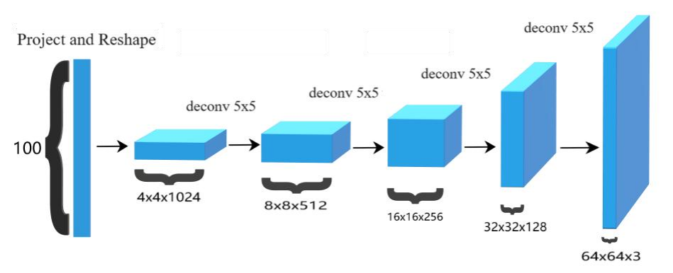
DCGAN : Generator
The generator (G) maps the latent space vector (z) to data-space, creating a 3x64x64 RGB image. It uses strided 2D convolutional transpose layers paired with batch normalization and ReLU activation. The output is passed through a tanh function to ensure values are within the range of [-1,1]. Batch normalization layers aid gradient flow during training, a key contribution of DCGANs.

Slide 11
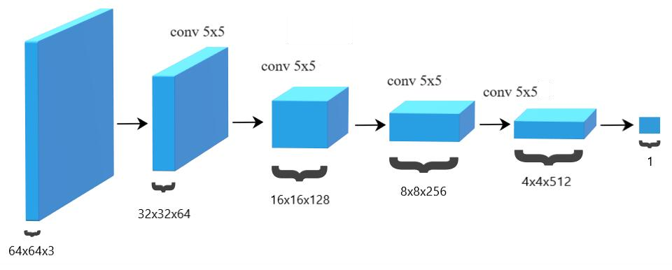
DCGAN : Discriminator
The discriminator (D) is a binary classification network that processes 3x64x64 input images through Conv2d, BatchNorm2d, and LeakyReLU layers, outputting a scalar probability of realness via a Sigmoid activation. Strided convolution, BatchNorm, and LeakyReLU are preferred for downsampling and healthy gradient flow.

Slide 12
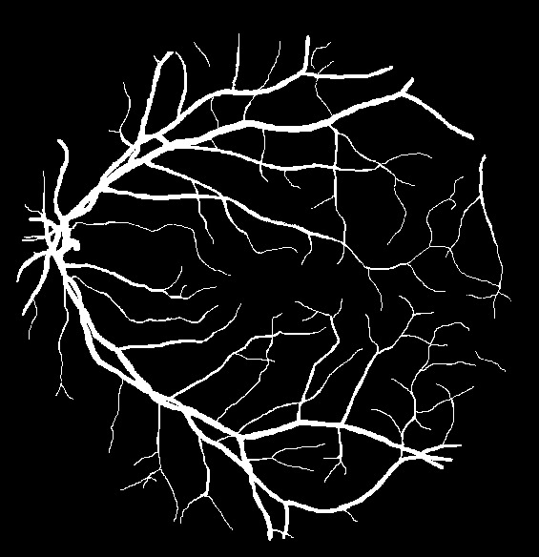

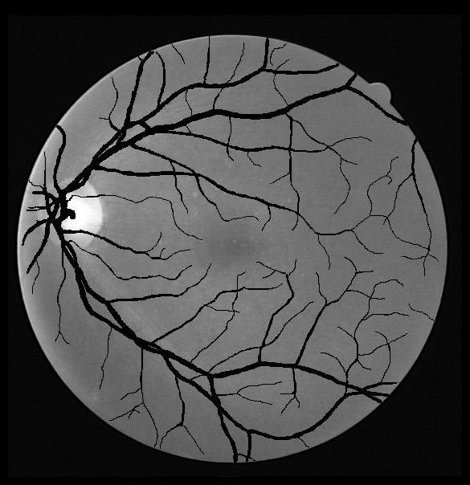
First Step
The images shown beside are used to first generate an image where blood vessels are removed in each BGR channel.
The green channel image and the ground truth image are compared and the pixels locations that have a value of more than 127 in the ground truth image; the same locations in the green channel retinal image are changed to a value of 0 that is the color black.
Through this procedure we get an image where only the blood vessels are highlighted in black color which makes it easier for selection henceforward.
Ground Truth
Retinal Image
Mask
New Image

Slide 13
In the next step we compare the mask image with the new green channel image obtained to get only the retinal portion of the image excluding the black background. This makes it easier to search for the black colored blood vessels.
Taking the neighbouring pixels of the black pixels we apply Bernstein equation and produce two images: one an image with horizontal traversal of pixel points and one with the vertical traversal of pixel points. Merging both the images will produce an image where the blood vessels are filled.

Slide 14
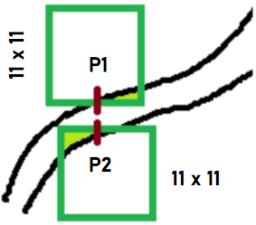
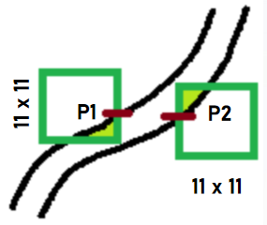
Matrix Window Logic
The logic used is creating a matrix window. We are creating two 11 x 11 matrices for neighbouring horizontal and vertical pixels of black pixels and then we are computing the average of the matrices which gives us P1 and P2. We apply this P1 and P2 values in the Bernstein equation.
Creating a matrix window gives us a more accurate average value that helps to fill the pixels points that are not coloured.
Vertical
Horizontal

Slide 15
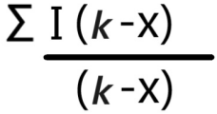
Irregularities
During matrix creation the image may contain some white and black pixels as noise and hence we are ignoring those pixels and then take the average of the remaining pixels using the equation:
where k is the matrix window size i.e k = 11 x 11 = 121 (here) and x is the number of black and white pixels we are ignoring.

Slide 16
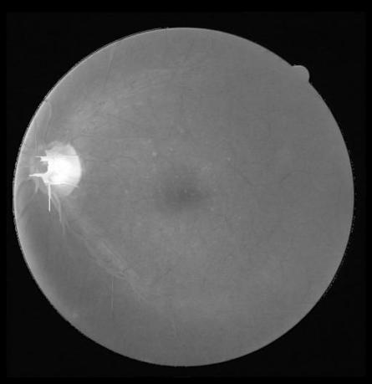
The Resultant New Green Image
After the blood vessels are completely filled we would get the resultant green channel image as shown below. The filled vessels closely resemble the color of the rest of internal retinal image.

Slide 17
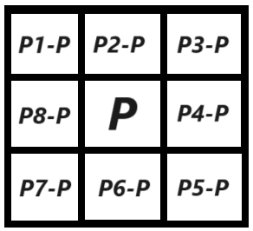
Feature Extraction
We use Sklearn Python library to apply the K-means clustering algorithm to perform region creation.
For feature extraction we take a 3x3 matrix window as shown in the figure beside and by subtracting middle pixel value with the rest we take the minimum value i.e.
<p, min> to add it as a feature.
3x3 matrix window

Slide 18
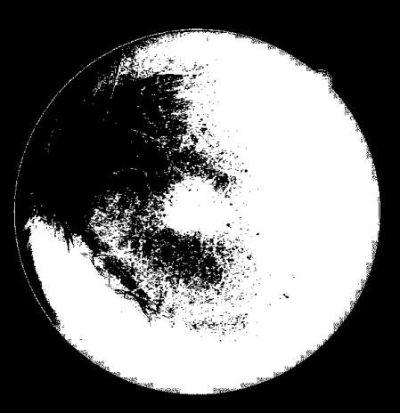
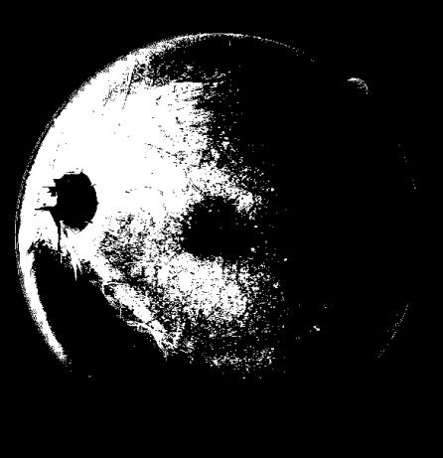
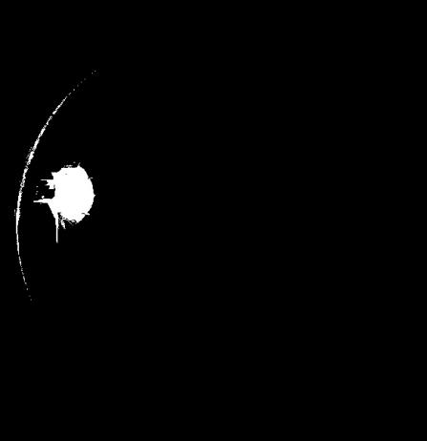
The Three Regions
The aim is to create three clusters or groupings of retinal images which will highlight the optic disk region, high contrast region and low contrast region.
The features are used to create the three clusters (k=3). From the green channel image we are finding out which pixel belongs to which cluster using their features. Filling up the exact pixel location as 255 in the corresponding cluster images.
High Contrast Region
Low Contrast Region
Optic Disc Region

Slide 19
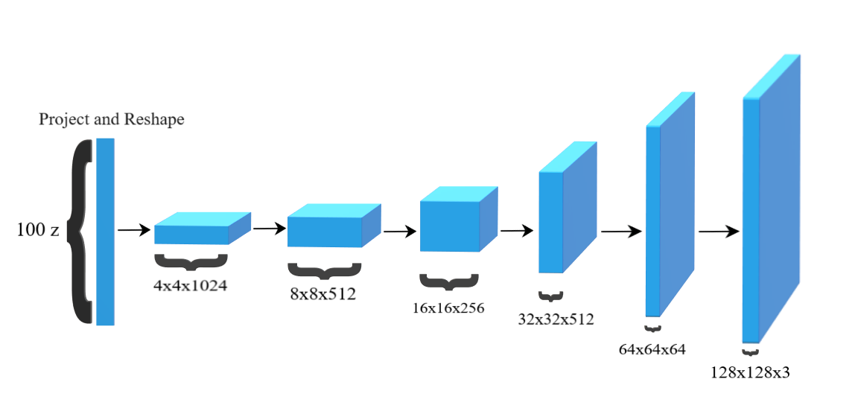
GAN Model: Generator
The generator (G) of our model maps the latent space vector (z) to data-space, creating a 3x128x128 RGB image. It uses strided 2D convolutional transpose layers paired with batch normalization and ReLU activation. The output is passed through a tanh function to ensure values are within the range of [-1,1].

Slide 20
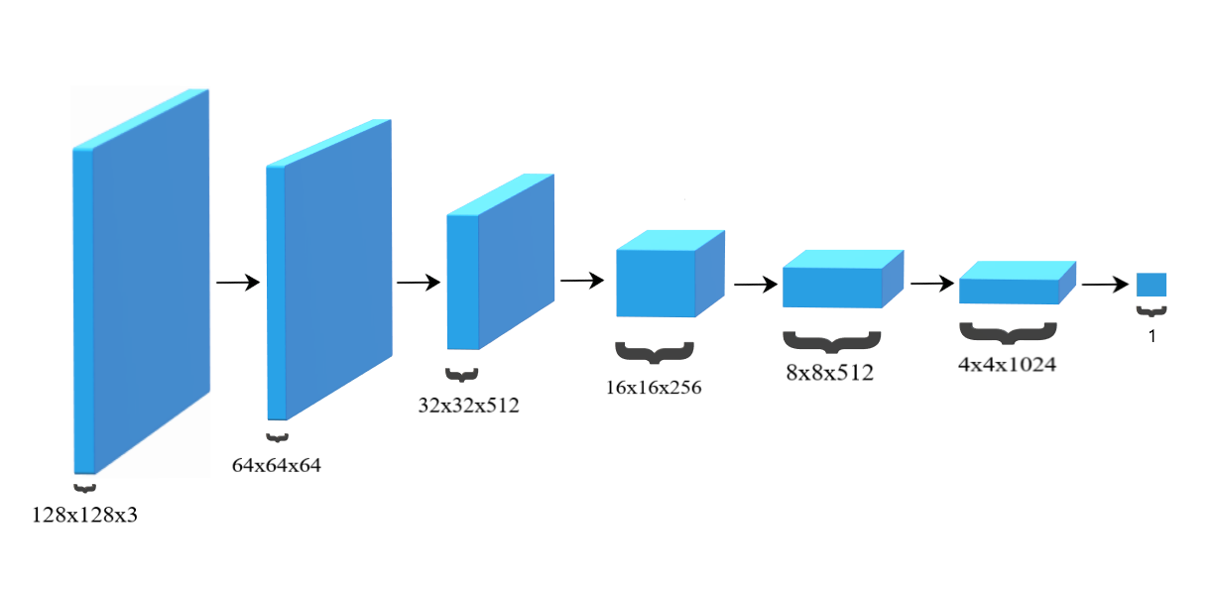
GAN Model: Discriminator
The discriminator (D) of our model processes 3x128x128 input images through Conv2d, BatchNorm2d, and LeakyReLU layers, outputting a scalar probability of realness via a Sigmoid activation.

Slide 21
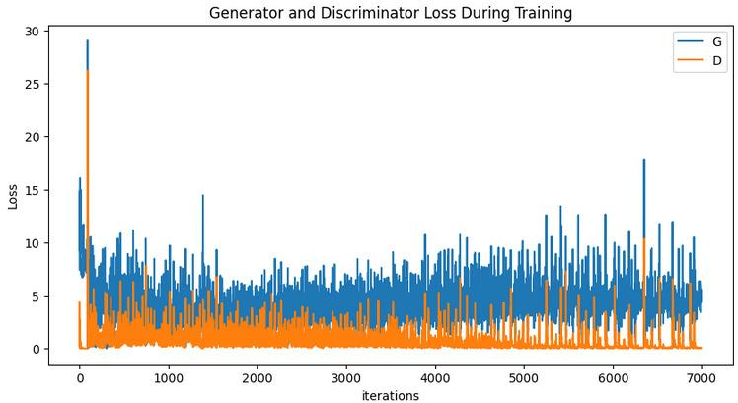
Graph
A loss graph is plotted that visualizes the training progress of both the generator (G) and discriminator (D) networks during training iterations.

Slide 22
Batch-wise data

Slide 23
Results

Slide 25
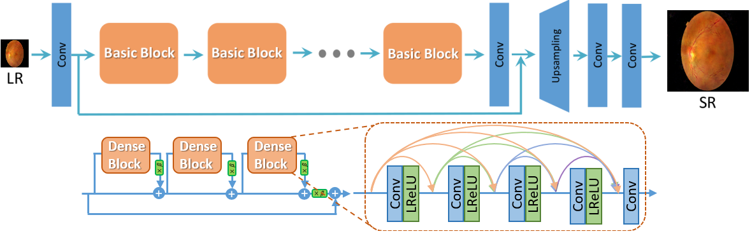
Resultant image enhancement using ESRGAN
In few words, image super-resolution (SR) techniques reconstruct a higher-resolution (HR) image or sequence from the observed lower_x0002_resolution (LR) images, e.g. upscaling of 720p image into 1080p. One of the common approaches to solving this task is to use deep convolutional neural networks capable of recovering HR images from LR ones andnd ESRGAN (Enhanced SRGAN) is one of them.

Slide 26
Output after super-resolution

Slide 27
Conclusion

Slide 28
Future Scope
A major goal for us is the generation of all the three regions and train our GAN model to further enhance the imaging aspect of the retinal fundus images.
In future endeavors, the integration of high contrast and low contrast regions alongside the optic disk region represents a promising avenue for enhancing the quality and diversity of synthetic retinal fundus images generated by the GAN. By incorporating additional regions of interest and varying contrast levels, we can provide the GAN with a more comprehensive understanding of retinal anatomy and pathology, ultimately improving its ability to generate realistic and clinically relevant images.

Slide 29
THANK YOU

